Slide 1
Main Problem
Pe0ple face many problems while registering their complains regarding pollution and various enviromental issues(Dumping of waste ,cutting of trees ,minimum plantation ,avoiding rain water harvesting etc.) such as unfullfillment of govt. policies , not hearing of public complaints and user can't track the status of their problems and complains.

Slide 2
Complaint TRACKER
Citizen
Register Complaint
Acknowledgement through SMS/e-Mail
Forwarding of Complaint to the Organization Concerned
Online Status Tracking
ATR
Forwarding of Complaint to the concerned field office
Complaint received in hard copy scanned / uploaded
Acknowledgment: Online /post
Online transfer to GOVT dept.
Complains monitored

Slide 3
Complaint Flow
Complaints from Citizen
Receipt of Complaints by Nodal Agencies/
Apex Organizations
Assessment of Complaints by Public Complaint Officer to Take them up with Ministry/Department concerned
Action Report
Action Report
Concerned Ministry/Department receives the Complaint and the Director of Public Complaints makes Assessment
Action Report
Does it pertain to Ministry/ Department itself ?
Case forwarded to Sub-org/ Attached office
No
Yes
Case Taken up within office for redress
Action Report
Case can further be forwarded to field units, if necessary

Slide 4
Objectives of Eco Rajasthan
To facilitate Citizens through
Online lodging of Complaints
Viewing status and keeping track of the Complaint(s) lodged
Provision of Reminder and Feedback
To facilitate Nodal
Online forwarding of the Complaint received to concerned ministries/Departments
Online Monitoring of Waste Disposal
To facilitate Public Complaint Officers
Online forwarding/processing of the Complaint received
Online disposal/ closure of Complaint
Efficient & Speedy redress of public Complaints

Slide 5
Eco Rajasthan : The interfaces
The Public Complaint Redress portal has the interfaces for
Citizen to lodge/monitor Complaints
Ministries & Departments to manage the Complaints and send ATRs through Eco Rajasthan
PMO
http://www.pmindia.gov.in/en/
Presidents' Secretariat
http://helpline.rb.nic.in/
D/o Pension
http://pensionersportal.gov.in/
DARPG
http://pgportal.gov.in/
DPG, Cabinet Secretariat
http://dpg.gov.in/

Slide 6
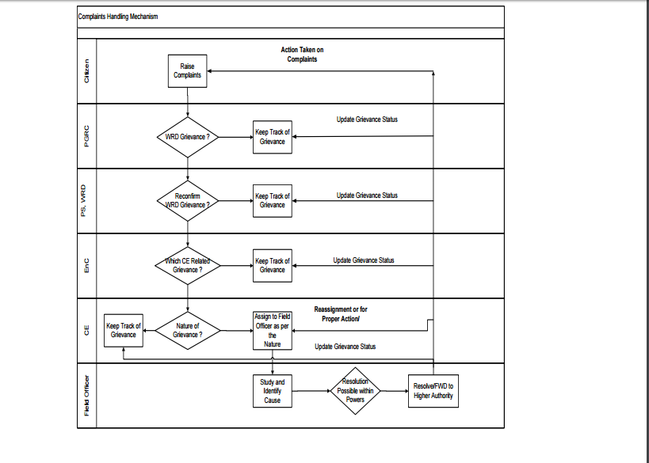

Slide 7
Illustration of
Eco Rajasthan

Slide 8
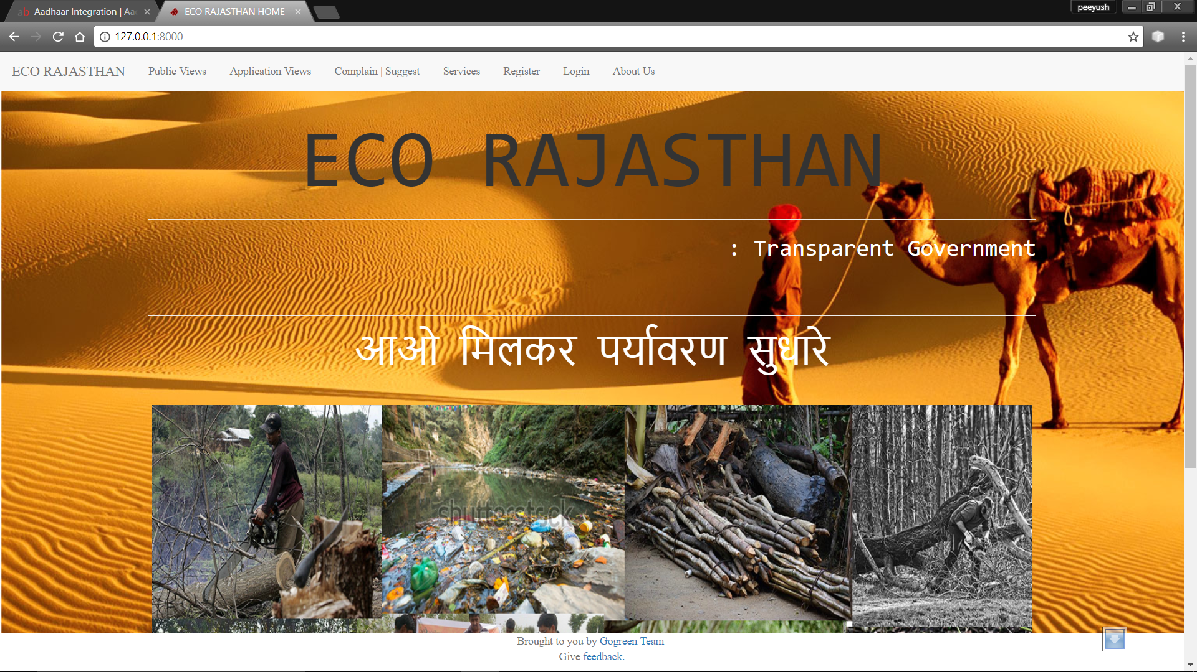
Home Page…

Slide 9
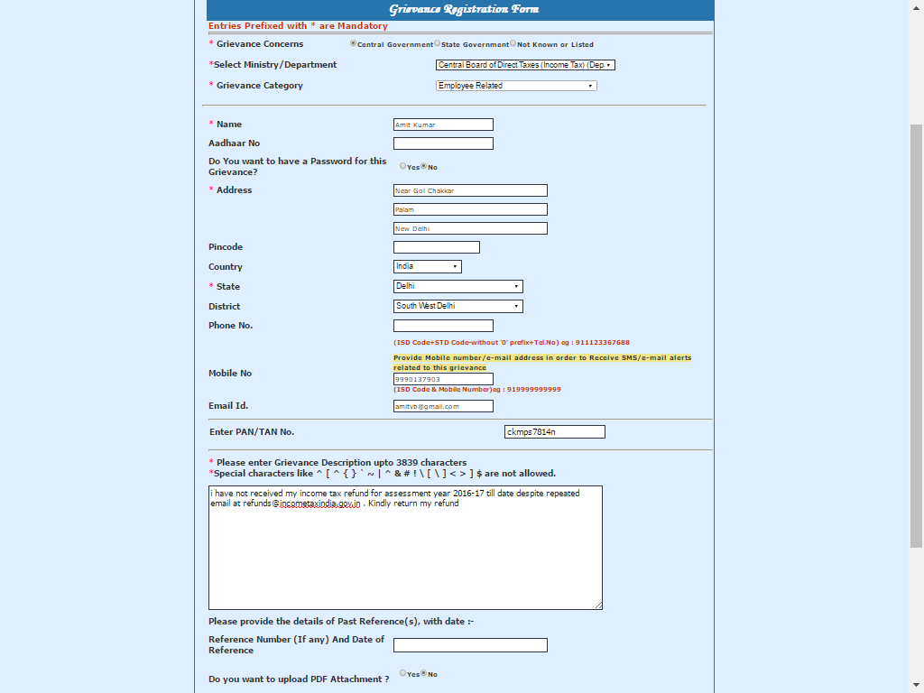

Slide 10
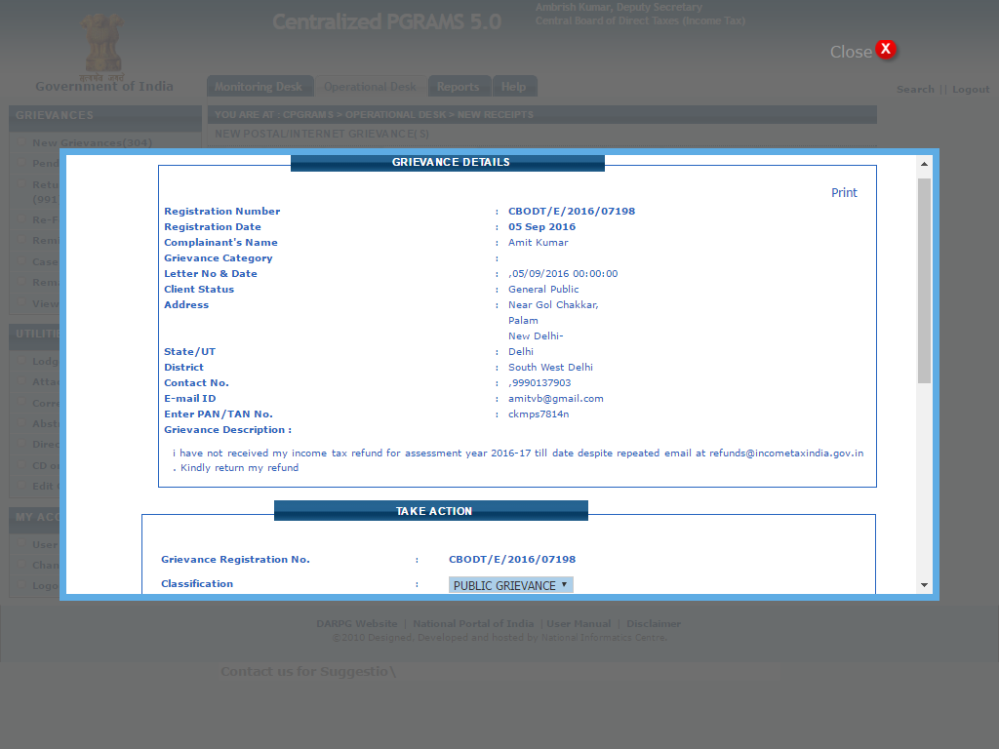

Slide 11
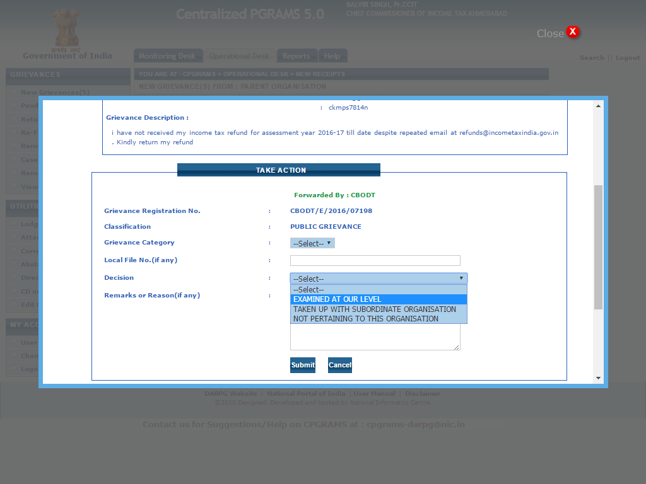

Slide 12
Highlights of Eco Rajasthan…
Online Receipt of Complaints forwarded by Nodal agencies
Online receipt of Complaints by Ministry/Department lodged through Internet by citizens.
Lodging of Complaints in the system received locally in respective offices of Ministry/Department/ Organization.
Provision to Ministry/Department/Organization to create subordinate organisations
Online Forwarding of Complaints to subordinate organizations.
SMS Alerts to citizens at different stages
Citizen can view the status at any point of time
E-mail & SMS alert to the citizen as soon as a complaint is lodged.
SMS alert to Secretary and Nodal PG Officer of Ministry/ Department regarding Pendency and rate of Disposal
Various Monitoring reports at all levels
Attachment of documents while lodging the Complaint
Attachment of supporting documents while sending the ATR to the higher authority

Slide 13
Thank You

